Slide 1
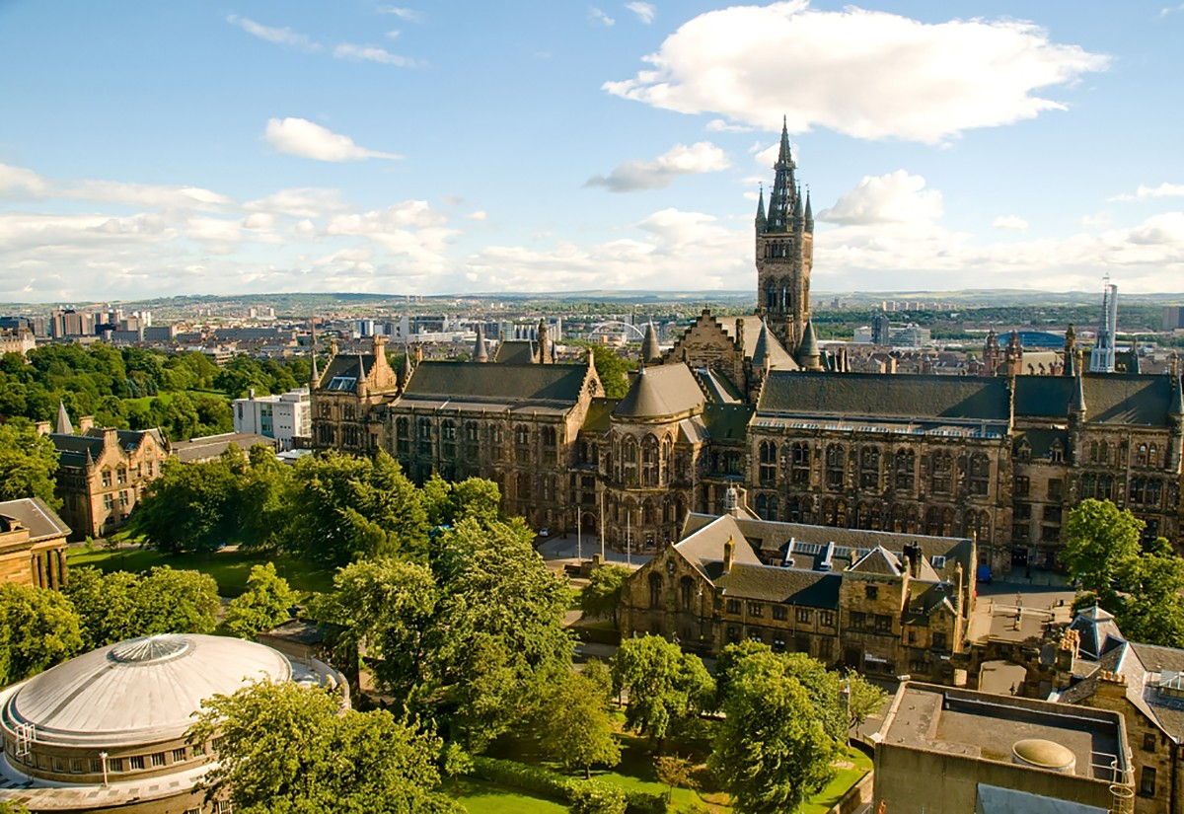

Constrained and Multiobjective Optimization
Bo Liu,
Professor,
James Watt School of Engineering,
University of Glasgow, UK

Slide 2
Constrained Optimization

Slide 3
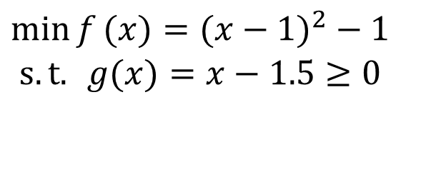



Constrained optimization
Objective vs. Constraint
objective function
$$\begin{matrix}\min{f}(x)=(x−1)^{2}−1 \\ s.t.{ }g(x)=x−1.5≥0\end{matrix}$$
Objective function
constraint
$$f\left(x\right)$$
0
$$1.5$$
$$x$$
g(x) ≥ 0

Slide 4

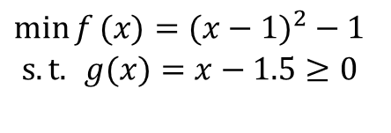



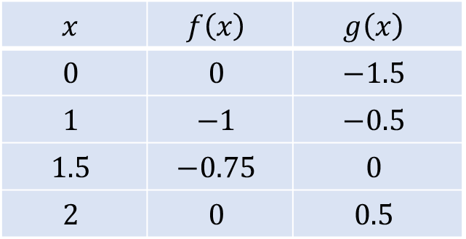

Comparing solutions in constrained optimization
Which solution is the best, and how to compare them?
$$\begin{matrix}\min{f}(x)=(x−1)^{2}−1 \\ s.t.{ }g(x)=x−1.5≥0\end{matrix}$$
$$f\left(x\right)$$
0
$$1$$
$$1.5$$
$$2$$
$$x$$ | $$f\left(x\right)$$ | $$g\left(x\right)$$
$$0$$ | $$0$$ | $$−1.5$$
$$1$$ | $$−1$$ | $$−0.5$$
$$1.5$$ | $$−0.75$$ | $$0$$
$$2$$ | $$0$$ | $$0.5$$
$$x$$
g(x) ≥ 0

Slide 5
Objectives and constraints
What is the difference between objective functions and constraints?
Objective: the smaller the better (considering a minimization problem, how about maximization?)
Constraint: only feasible or infeasible:
feasible solutions are considered the same.
infeasible solutions have different quality.

Slide 6
Rank solutions for a constrained optimization problem
Constrained optimization
How to rank the solutions?
Feasible solutions are better than infeasible solutions
For two feasible solutions, the one with a better objective function value is better
For two infeasible solutions, the one with a smaller constraint violation is better

Slide 7
Handling constraints: describe constraint violation
Sum of the constraint violation
Case 1: total weight is 10kg vs. the requirement of 7kg (violation is 3kg), total volume is 70cm³ vs. the requirement of 60cm³ (violation of 10cm³)
Case 2: Some constraints may have priority.
Weighted sum of the constraint violation

Slide 8
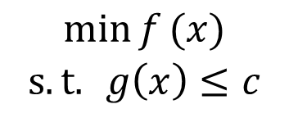
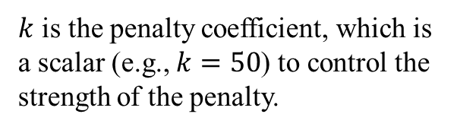
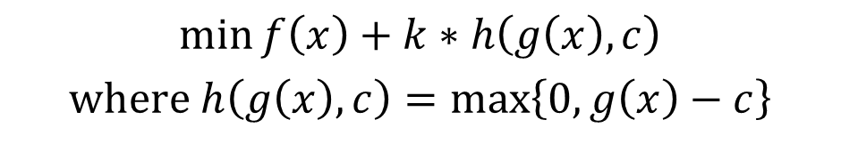
Handling constraints: penalty function method
Equivalently, we can transform the above to the unconstrained problem as follows:
$$\begin{matrix}\min{f}(x) \\ s.t.{ }g\left(x\right)≤c \end{matrix}$$
$k$ is the penalty coefficient, which is a scalar (e.g., $k=50$) to control the strength of the penalty.
$$\min{f\left(x\right)+k∗h\left(g\left(x\right),c\right)}$$
$$where h\left(g\left(x\right),c\right)=\max\left\{0,g\left(x\right)−c\right\}$$
The more the constraint is violated, the more the penalty will be.
The penalty function
When the constraint is satisfied, the penalty has no effect on the objective function.

Slide 9

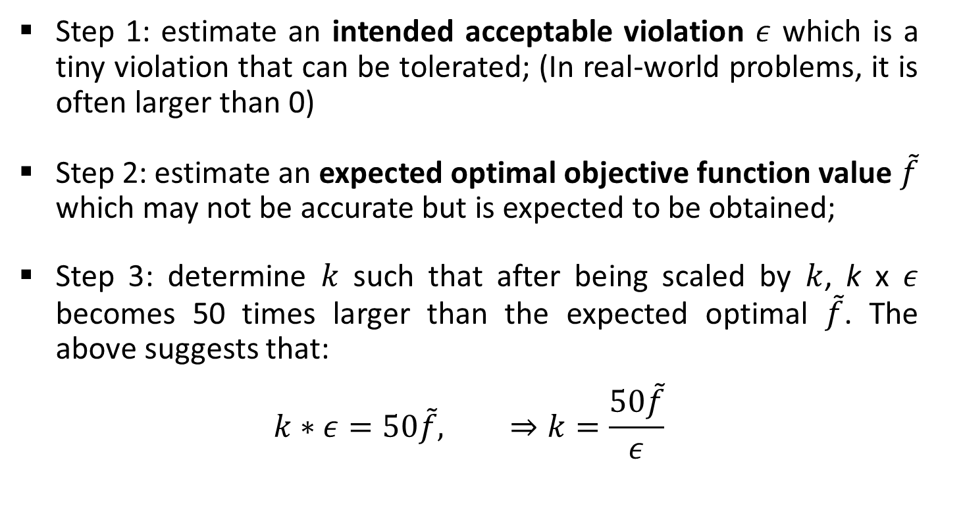
How to determine the penalty coefficient $k$?
An empirical method
Step 1: estimate an intended acceptable violation $ε$ which is a tiny violation that can be tolerated; (In real-world problems, it is often larger than 0)
Step 2: estimate an expected optimal objective function value $\tilde{f}$ which may not be accurate but is expected to be obtained;
Step 3: determine $k$ such that after being scaled by $k$, k x $ε$ becomes 50 times larger than the expected optimal $\tilde{f}$. The above suggests that:
$$k∗ε=50\tilde{f}, ⇒k=\frac{50\tilde{f}}{ε}$$

Slide 10
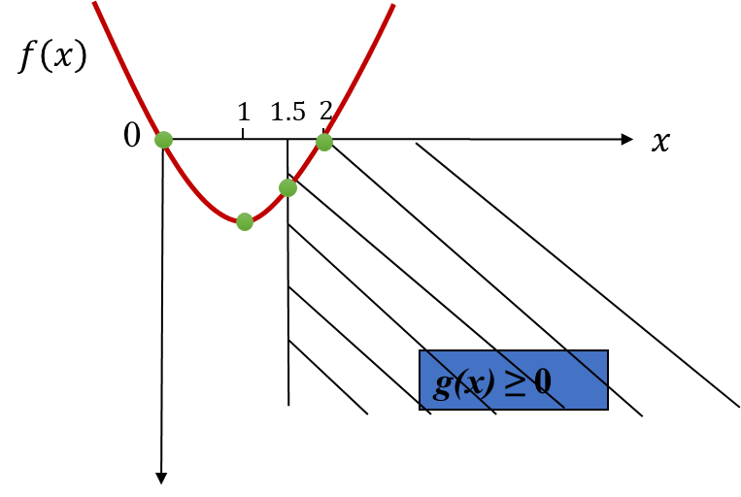
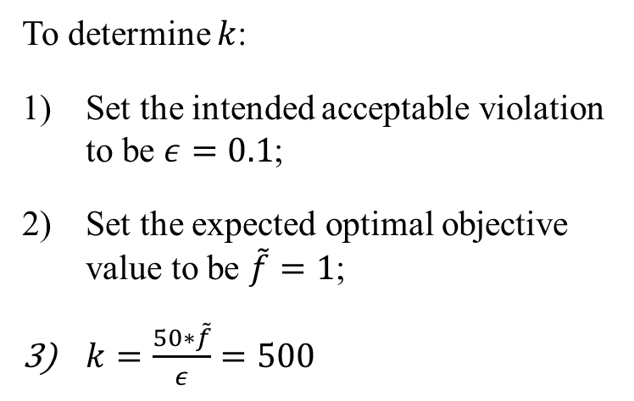
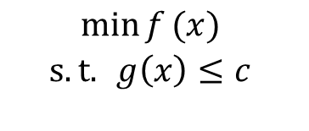
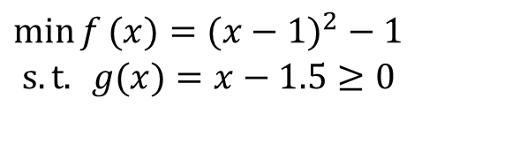
Handling constraints: penalty function method
$$\begin{matrix}\min{f}(x) \\ s.t.{ }g\left(x\right)≤c \end{matrix}$$
To determine $k$:
Set the intended acceptable violation to be $ε=0.1$;
Set the expected optimal objective value to be $\tilde{f}=1$;
$k=\frac{50∗\tilde{f}}{ε}=500$
$$\begin{matrix}\min{f}(x)=(x−1)^{2}−1 \\ s.t.{ }g(x)=x−1.5≥0\end{matrix}$$

Slide 11

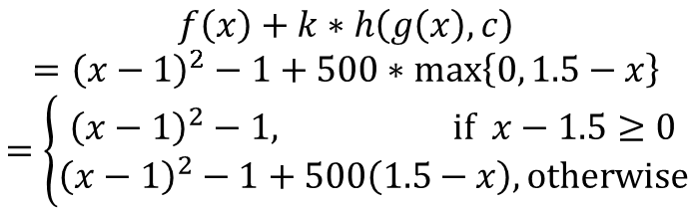







Handling constraints: penalty function method
$$\begin{matrix}\min{f}(x) \\ s.t.{ }g\left(x\right)≤c \end{matrix}$$
$$\min{f\left(x\right)+k∗h\left(g\left(x\right),c\right)}$$
$$where h\left(g\left(x\right),c\right)=\max\left\{0, g\left(x\right)−c\right\}$$
$$f\left(x\right)+k∗h\left(g\left(x\right),c\right)$$
$$={\left(x−1\right)}^{2}−1+500∗\max\left\{0, 1.5−x\right\}$$
$$=\left\{\begin{aligned}{\left(x−1\right)}^{2}−1, if x−1.5≥0 \\ {\left(x−1\right)}^{2}−1+500\left(1.5−x\right), otherwise\end{aligned}\right.$$
$$\begin{matrix}\min{f}(x)=(x−1)^{2}−1 \\ s.t.{ }g(x)=x−1.5≥0\end{matrix}$$
$$1.5−x<0$$
$${\left(x−1\right)}^{2}−1$$
0
$$1$$
$$1.5$$
$$2$$
$${\left(x−1\right)}^{2}−1+500∗\left(1.5−x\right)$$
$$1.5−x>0$$

Slide 12
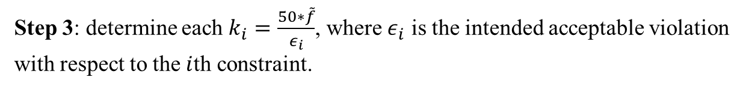
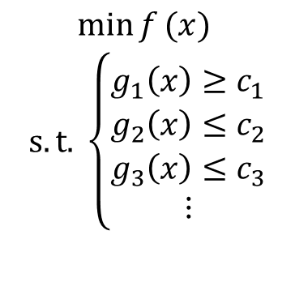
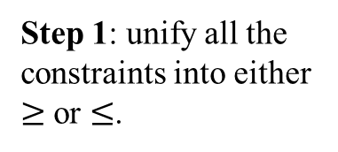
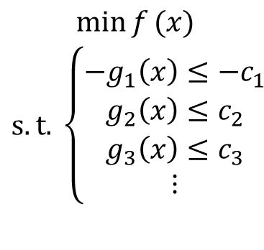
What if there are multiple constraints?
$$\begin{matrix}\min{f}(x) \\ s.t.{ \left\{\begin{aligned}g_{1}\left(x\right)≥c_{1} \\ g_{2}\left(x\right)≤c_{2} \\ g_{3}\left(x\right)≤c_{3} \\ ⋮\end{aligned}\right.}\end{matrix}$$
Step 1: unify all the constraints into either $≥$ or $≤$.
$$\begin{matrix}\min{f}(x) \\ s.t.{ \left\{\begin{aligned}−g_{1}\left(x\right)≤−c_{1} \\ g_{2}\left(x\right)≤c_{2} \\ g_{3}\left(x\right)≤c_{3} \\ ⋮\end{aligned}\right.}\end{matrix}$$
Step 2: integrate all the constraints into the objective by the penalty function method
$$\min{f\left(x\right)+k_{1}h\left(−g_{1}\left(x\right),−c_{1}\right)+k_{2}h(g_{2}\left(x\right),c_{2}) }+k_{3}h\left(g_{3}\left(x\right), c_{3}\right)+…$$
$k_{i}$ the penalty strength for the violation of the $i_{th}$ constraint.
Step 3: determine each $k_{i}=\frac{50∗\tilde{f}}{ε_{i}}$, where $ε_{i}$ is the intended acceptable violation with respect to the $i$th constraint.

Slide 13
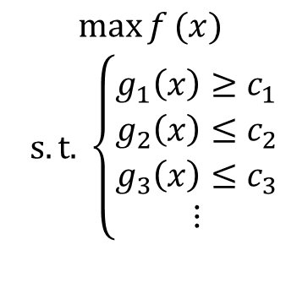
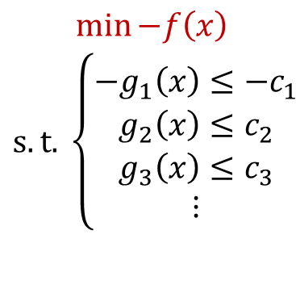
What if we are doing maximization?
$$\begin{matrix}\max{f}(x) \\ s.t.{ \left\{\begin{aligned}g_{1}\left(x\right)≥c_{1} \\ g_{2}\left(x\right)≤c_{2} \\ g_{3}\left(x\right)≤c_{3} \\ ⋮\end{aligned}\right.}\end{matrix}$$
$$\begin{matrix}\min{−f\left(x\right)} \\ s.t.{ \left\{\begin{aligned}−g_{1}\left(x\right)≤−c_{1} \\ g_{2}\left(x\right)≤c_{2} \\ g_{3}\left(x\right)≤c_{3} \\ ⋮\end{aligned}\right.}\end{matrix}$$
All we need is to put a negative side to the objective, which transforms the problem into minimization, and the rest are the same as the previous slides.

Slide 14
Does the penalty function method follow these principles?
Constrained optimization
How to rank the solutions?
Feasible solutions are better than infeasible solutions
For two feasible solutions, the one with a better objective function value is better
For two infeasible solutions, the one with a smaller constraint violation is better
It is, if the penalty coefficient is appropriate.

Slide 15
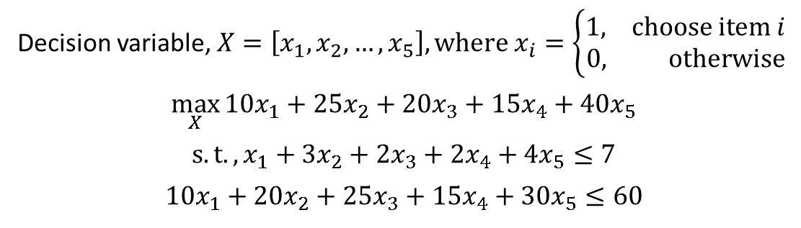
Example: knapsack problem
Knapsack problem
Five items with different values and weights
A knapsack with maximum capacity
$10
$25
$20
item 1
item 2
item 3
1kg, 10cm³
3kg, 20cm³
2kg, 25cm³
$15
$40
item 4
item 5
Capacity:
7 kg and 60cm³
2kg, 15cm³
4kg, 30cm³
Decision variable, $X=\left[x_{1},x_{2},…,x_{5}\right], where x_{i}=\left\{\begin{aligned}1, choose item i \\ 0, otherwise\end{aligned}\right.$
$$\max_{X}{10x_{1}+25x_{2}+20x_{3}+15x_{4}+40x_{5}}$$
$$s.t., x_{1}+3x_{2}+2x_{3}+2x_{4}+4x_{5}≤7$$
$$10x_{1}+20x_{2}+25x_{3}+15x_{4}+30x_{5}≤60$$

Slide 16
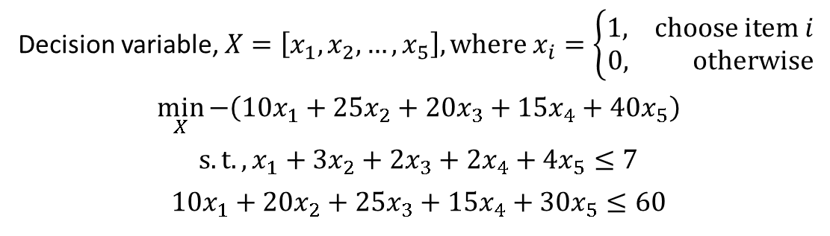
Example: knapsack problem
Knapsack problem
Five items with different values and weights
A knapsack with maximum capacity
$10
$25
$20
item 1
item 2
item 3
1kg, 10cm³
3kg, 20cm³
2kg, 25cm³
$15
$40
item 4
item 5
Capacity:
7 kg and 60cm³
2kg, 15cm³
4kg, 30cm³
Decision variable, $X=\left[x_{1},x_{2},…,x_{5}\right], where x_{i}=\left\{\begin{aligned}1, choose item i \\ 0, otherwise\end{aligned}\right.$
$$\min_{X}{−\left(10x_{1}+25x_{2}+20x_{3}+15x_{4}+40x_{5}\right)}$$
$$s.t.,x_{1}+3x_{2}+2x_{3}+2x_{4}+4x_{5}≤7$$
$$10x_{1}+20x_{2}+25x_{3}+15x_{4}+30x_{5}≤60$$
Step 1: convert the problem to minimization.

Slide 17
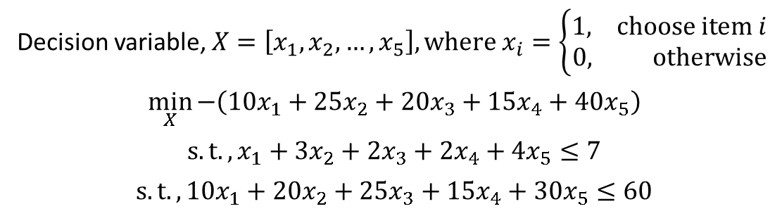
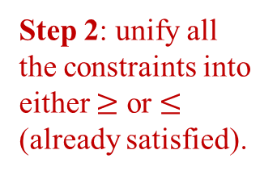
Example: knapsack problem
Knapsack problem
Five items with different values and weights
A knapsack with maximum capacity
$10
$25
$20
item 1
item 2
item 3
1kg, 10cm³
3kg, 20cm³
2kg, 25cm³
$15
$40
item 4
item 5
Capacity:
7 kg and 60cm³
2kg, 15cm³
4kg, 30cm³
Decision variable, $X=\left[x_{1},x_{2},…,x_{5}\right], where x_{i}=\left\{\begin{aligned}1, choose item i \\ 0, otherwise\end{aligned}\right.$
$$\min_{X}{−\left(10x_{1}+25x_{2}+20x_{3}+15x_{4}+40x_{5}\right)}$$
$$s.t.,x_{1}+3x_{2}+2x_{3}+2x_{4}+4x_{5}≤7$$
$$s.t.,10x_{1}+20x_{2}+25x_{3}+15x_{4}+30x_{5}≤60$$
Step 2: unify all the constraints into either $≥$ or $≤$ (already satisfied).

Slide 18
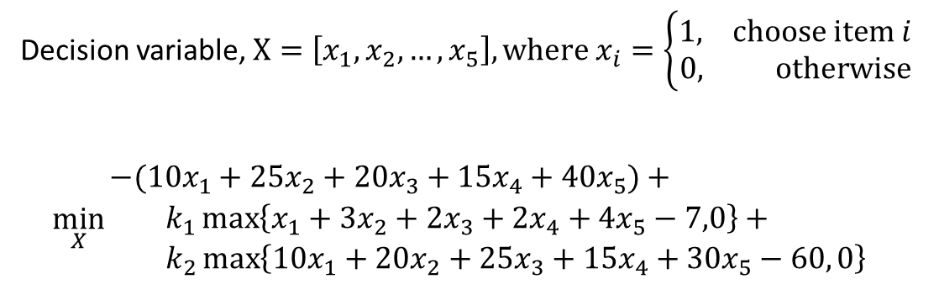
Example: knapsack problem
Knapsack problem
Five items with different values and weights
A knapsack with maximum capacity
$10
$25
$20
item 1
item 2
item 3
1kg, 10cm³
3kg, 20cm³
2kg, 25cm³
$15
$40
item 4
item 5
Capacity:
7 kg and 60cm³
2kg, 15cm³
4kg, 30cm³
Decision variable, $X=\left[x_{1},x_{2},…,x_{5}\right], where x_{i}=\left\{\begin{aligned}1, choose item i \\ 0, otherwise\end{aligned}\right.$
$$\min_{X}{\begin{matrix}−(10x_{1}+25x_{2}+20x_{3}+15x_{4}+40x_{5})+ \\ k_{1}\max\left\{x_{1}+3x_{2}+2x_{3}+2x_{4}+4x_{5}−7,0\right\}+ \\ k_{2}\max\left\{10x_{1}+20x_{2}+25x_{3}+15x_{4}+30x_{5}−60, 0\right\}\end{matrix}}$$
Step 3: integrate all the constraints into the objective by the penalty function method

Slide 19
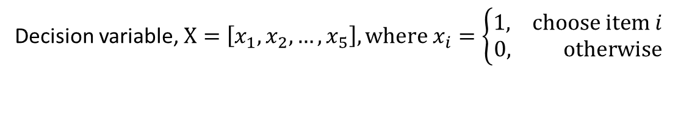
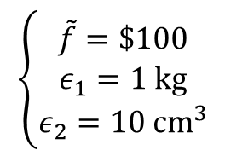
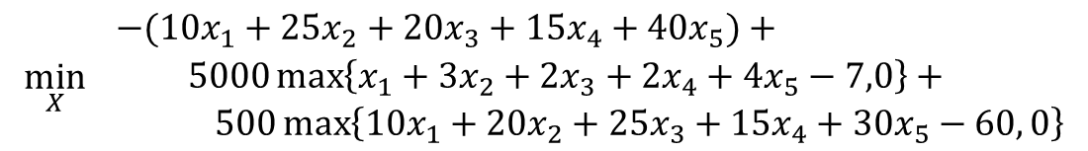
Example: knapsack problem
Knapsack problem
Five items with different values and weights
A knapsack with maximum capacity
$10
$25
$20
item 1
item 2
item 3
1kg, 10cm³
3kg, 20cm³
2kg, 25cm³
$15
$40
item 4
item 5
Capacity:
7 kg and 60cm³
2kg, 15cm³
4kg, 30cm³
Decision variable, $X=\left[x_{1},x_{2},…,x_{5}\right], where x_{i}=\left\{\begin{aligned}1, choose item i \\ 0, otherwise\end{aligned}\right.$
Step 3: determine the penalty coefficients
$$\left\{\begin{aligned}\tilde{f}=\$100 \\ ε_{1}=1 kg \\ ε_{2}=10 cm^{3}\end{aligned}\right.$$
$$\min_{X}{\begin{matrix}−(10x_{1}+25x_{2}+20x_{3}+15x_{4}+40x_{5})+ \\ 5000\max\left\{x_{1}+3x_{2}+2x_{3}+2x_{4}+4x_{5}−7,0\right\}+ \\ 500\max\left\{10x_{1}+20x_{2}+25x_{3}+15x_{4}+30x_{5}−60, 0\right\}\end{matrix}}$$
Notes:
Estimate acceptable violations (>0)
Estimate the level of the optimal value of the objective function
Penalty coefficients x acceptable violation = 50 x optimal value for each constraint

Slide 20
MATLAB Implementation for Constrained Optimization

Slide 21
Code structure
Demo_Knapsack.m
Entrance of program, a five-item 0-1 Knapsack problem example.
Penalty_function_method.m
A demonstration of how to write penalty function method.

Slide 22
Evaluation with the penalty function method
function fitness = knapsack_pfm(values, weights, maxWeight, w_penalty, volumes, maxVolume, v_penalty, population)
% fitness evaluator for the knapsack problem, where the constraints are processed by the penalty function method
fitness = -values*population.’; % convert the problem to minimization
w_const = weights*population.'; % compute the weight constraint
v_const = volumes*population.'; % compute the volume constraint
fitness = fitness + w_penalty * max(maxWeight - w_const, 0);
fitness = fitness + v_penalty * max(maxVolume - v_const, 0);
end

Slide 23
Multiobjective Optimization

Slide 24
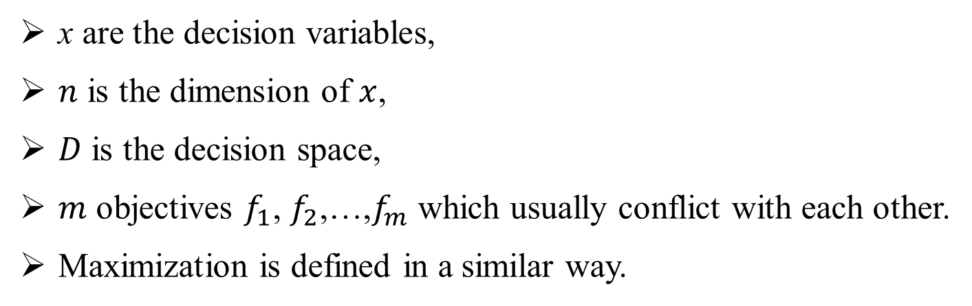
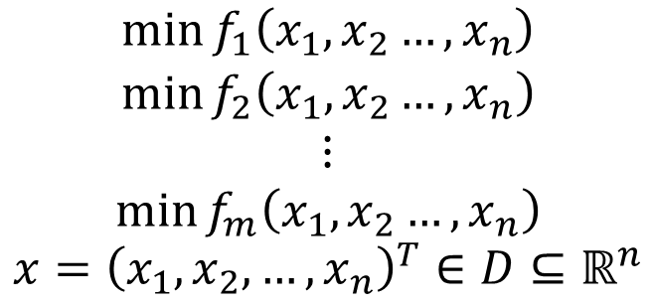
Multiobjective optimization problem (MOP)
$$\begin{matrix}\begin{aligned}\min{f_{1}\left(x_{1},x_{2}…,x_{n}\right)} \\ \min{f_{2}\left(x_{1},x_{2}…,x_{n}\right)}\end{aligned} \\ ⋮ \\ \min{f_{m}\left(x_{1},x_{2}…,x_{n}\right)}\end{matrix}$$
$$x={\left(x_{1},x_{2},…,x_{n}\right)}^{T}∈D⊆ℝ^{n}$$
x are the decision variables,
$n$ is the dimension of $x$,
$D$ is the decision space,
$m$ objectives $f_{1}$, $f_{2}$,…,$f_{m}$ which usually conflict with each other.
Maximization is defined in a similar way.
Note: the problems considered hereafter are all minimization.

Slide 25
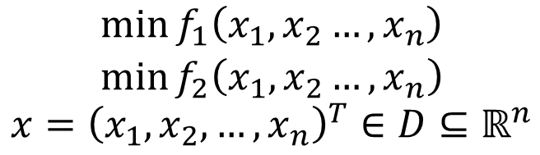
Example: automobile design
When designing an automobile, we concern on several aspects such as the performance, safety, energy efficiency, and cost of production.
The energy consumption (per hundred miles) should be as low as possible. The lower, the better.
The cost of manufacturing should be as low as possible. The lower, the better.
They conflict with each other. Low energy consumption relies on more advanced power unit design, which in turns increases the cost of manufacturing.
$$\begin{matrix}\min{f_{1}\left(x_{1},x_{2}…,x_{n}\right)} \\ \min{f_{2}\left(x_{1},x_{2}…,x_{n}\right)}\end{matrix}$$
$$x={\left(x_{1},x_{2},…,x_{n}\right)}^{T}∈D⊆ℝ^{n}$$

Slide 26
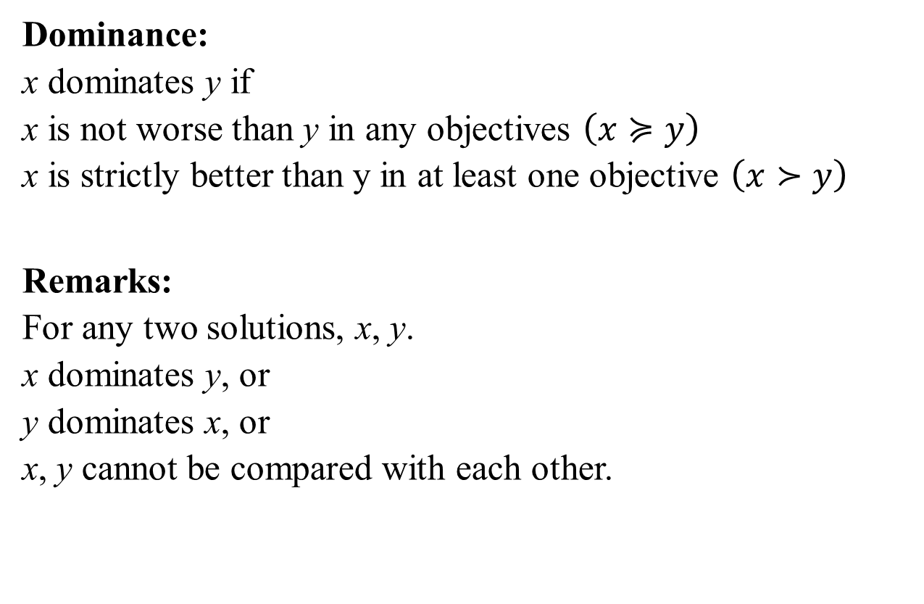
Which solutions are optimal?
How to measure the quality of solutions? dominance
Dominance:
x dominates y if
x is not worse than y in any objectives $\left(x≽y\right)$
x is strictly better than y in at least one objective $\left(x≻y\right)$
Remarks:
For any two solutions, x, y.
x dominates y, or
y dominates x, or
x, y cannot be compared with each other.

Slide 27


Dominance: illustration
$$f_{2}$$
A
F(A)
F(B)
B
F(C)
C
$$f_{1}$$
Search space
Objective space
y dominates x if and only if:
y is no worse than x in any objective, and
y is better than x in at least one objective.
In this example:
B dominates A;
B and C are not comparable, and so do A and C.

Slide 28

Which solutions are optimal?
Pareto front (PF)
Pareto front:
A collection of points not dominated by any solutions in $D$.
f₁
Dominated by x
y
x
Pareto front
Minimization
f₂

Slide 29





Different shapes of the PF
$$f_{2}$$
$$f_{2}$$
Minimization
Convex
$$f_{1}$$
Concave
$$f_{1}$$
$$f_{2}$$
$$f_{2}$$
$$f_{1}$$
$$f_{1}$$
Discontinuous
Neither Convex nor Concave

Slide 30


Pareto optimal solutions = best trade-off candidates
x is Pareto optimal if and only if no other solution dominates it.
A (rational) decision maker does not like non-Pareto optimal solutions.
Search Space
$$f_{2}$$
PF
PS
$$f_{1}$$

Slide 31
Pareto set & front (PS & PF)
Pareto Set (PS)
Pareto-optimal solution:
Solutions that are not dominated by any other solutions
Pareto set (PS): the set of all the Pareto optimal solutions, a subset of the decision space.
Pareto front (PF): the set of objective function values of all the solutions in the PS, a subset of the objective space.
Minimization
Pareto front (PF)

Slide 32
What’s next?
Now that we have learnt both evolutionary algorithms (EAs) and MOPs…
How to use EAs to solve MOPs?

Slide 33
MOEA/D

Slide 34


Population-based iterative search methods
Evolutionary algorithms
One iteration in a simple EA
Population at generation $t$
Parent Set
Population at generation $t+1$
Crossover
Mutation
……
Selection
Population: a set of candidate solutions.
Selection: select fittest solutions to be parents for the next generation.
Crossover: exchange information from two parent solutions to produce new solutions.
Mutation: modify an existing solution.

Slide 35
Multiobjective evolutionary algorithms (MOEAs)
Generate a number of solutions
to approximate the PF (PS) or
to provide some other useful information to the decision makers, such as how different objectives compromise with each other.
Minimization
Popular in computer science and many other engineering areas.
Mainstream methodology in Multi-Criterion Decision Making.
The hottest research area in evolutionary computation field (over 15K research papers).
Notes:
For the example figure, when f1 becomes worse, f2 does not improve much (minimization problem).

Slide 36




What do we want from MOEA?
A finite number of evenly distributed Pareto optimal solutions that can well approximate the PF.
$$f_{2}$$
$$f_{2}$$
Minimization
PF
PF
$$f_{1}$$
$$f_{1}$$
a) Objective space
b) Objective space
Intuitively, (a) approximates the PF more accurately than (b).

Slide 37


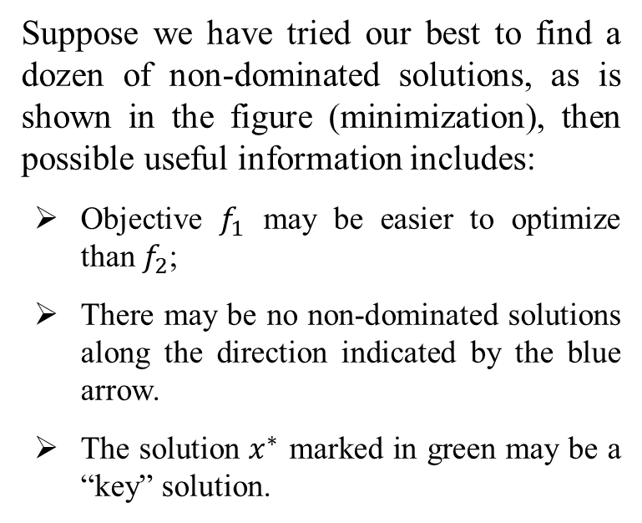

Other information to the decision makers: an example
Suppose we have tried our best to find a dozen of non-dominated solutions, as is shown in the figure (minimization), then possible useful information includes:
Objective $f_{1}$ may be easier to optimize than $f_{2}$;
There may be no non-dominated solutions along the direction indicated by the blue arrow.
The solution $x^{∗}$ marked in green may be a “key” solution.
$$f_{2}$$
Minimization
$$x^{∗}$$
a) Objective space
$$f_{1}$$
Notes:
For the third bullet point: This is because, if we start from $x^{∗}$ and continue to optimize $f_{1}$, $f_{2}$ can be greatly worsen. On the other hand, if we start from $x^{∗}$ and continue to optimize $f_{2}$, we can hardly achieve much gain.

Slide 38
Popular MOEA variants
MOEA/D^{[1]}: Decomposition-based MOEAs
To decompose a MOP into several single-objective subproblems, and to approximate the PF by solving the subproblems collaboratively.
NSGA-II^{[2]}: Dominance-based MOEAs
To iteratively select a new population based on 1) the Pareto-dominance relationship among solutions and 2) the distance in the objective space among solutions.
IBEA^{[3]}: Indicator-based MOEAs
To apply an indicator (e.g., hypervolume) to evaluate the quality of a set of solutions, and to iteratively select a new population based on the contribution of solutions to the indicator.
[1] Q. Zhang, H. Li. "MOEA/D: A multiobjective evolutionary algorithm based on decomposition." IEEE TEVC, 2007, 11(6), 712-731.
[2] Deb, Kalyanmoy, et al. "A fast and elitist multiobjective genetic algorithm: NSGA-II." IEEE TEVC, 2002, 6(2), 182-197.
[3] Zitzler, Eckart , and S. Künzli. "Indicator-Based Selection in Multiobjective Search." PPSN, 2004.

Slide 39
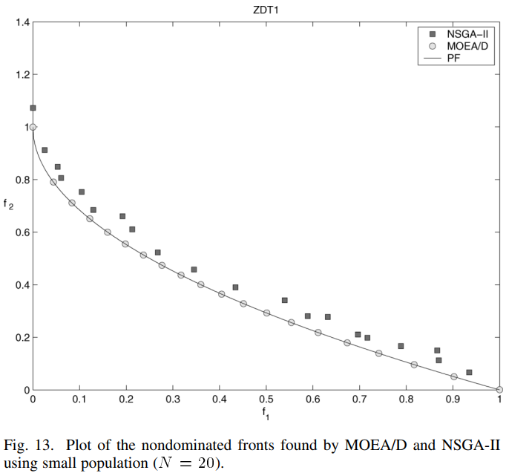
The advantages of MOEAs
In engineering:
Alignment with the users’ preferences
Users may have specific preferences over the objectives;
MOEA presumes multiple possible preferences of the users and aligns the solutions to those preferences.
Users can select solutions according to their own preferences.
ZHANG, Qingfu; LI, Hui. MOEA/D: A multiobjective evolutionary algorithm based on decomposition. IEEE Transactions on evolutionary computation, 2007, 11.6: 712-731.

Slide 40
The advantages of MOEA/D
In engineering:
Good distribution & high optimization quality with a small-population:
The population size is usually limited to a small number, due to the cost of simulations;
The idea of decomposition helps on obtaining a more uniform distribution of the final solutions;
The performance of MOEA/D is superior to NSGA-II considering a small-population.
Minimization
ZHANG, Qingfu; LI, Hui. MOEA/D: A multiobjective evolutionary algorithm based on decomposition. IEEE Transactions on evolutionary computation, 2007, 11.6: 712-731.

Slide 41
MOEA/D: decomposition + collaboration
Decomposition (from traditional optimization theory)
Decompose the task of approximating the PF into N subtasks. Each subproblem is usually single objective.
Collaboration (from evolutionary computation)
N agents (procedures) are used. Each agent is for a different subproblem.
These N subproblems are related to one another. N agents can solve these subproblems in a collaborative manner.

Slide 42
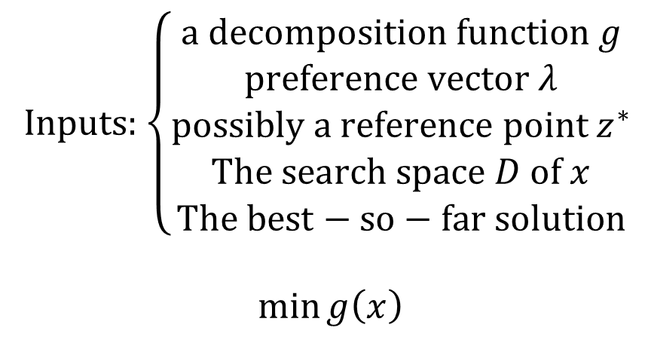
What does a subproblem contain?
Inputs: $\left\{\begin{aligned}\begin{aligned}\text{a} \text{decomposition} \text{function} g \\ \text{preference} \text{vector} λ \\ \text{possibly} \text{a} \text{reference} \text{point} z^{∗}\end{aligned} \\ The search space D of x \\ The best−so−far solution\end{aligned}\right.$
$$\min{g\left(x\right)}$$

Slide 43

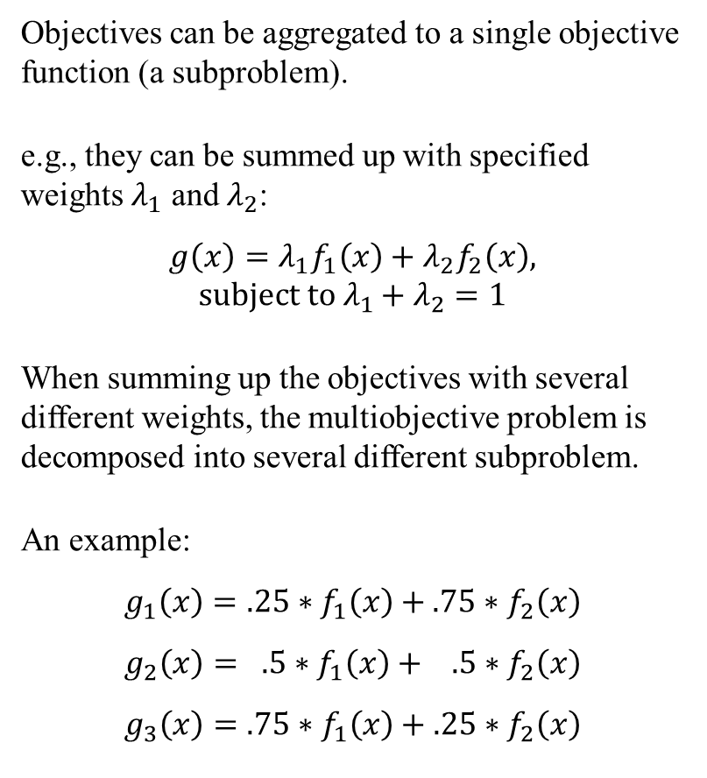

Objective decomposition in MOEA/D
Objectives can be aggregated to a single objective function (a subproblem).
e.g., they can be summed up with specified weights $λ_{1}$ and $λ_{2}$:
$$g\left(x\right)=λ_{1}f_{1}\left(x\right)+λ_{2}f_{2}\left(x\right), subject to λ_{1}+λ_{2}=1$$
When summing up the objectives with several different weights, the multiobjective problem is decomposed into several different subproblem.
An example:
$$g_{1}\left(x\right)=.25∗f_{1}\left(x\right)+.75∗f_{2}\left(x\right)$$
$$g_{2}\left(x\right)= .5∗f_{1}\left(x\right)+ .5∗f_{2}\left(x\right)$$
$$g_{3}\left(x\right)=.75∗f_{1}\left(x\right)+.25∗f_{2}\left(x\right)$$
$$f_{2}$$
Minimization
Subproblem 1
Subproblem 2
…
Subproblem $K$
$$f_{1}$$
Objective space

Slide 44
Popular decomposition methods
Weighted sum approach
Tchebycheff approach

Slide 45

Weighted sum approach
Minimization
Contour line. Points on the same contour have the identical $g$ values.
It works for convex PF.
Pareto optimal solution
Approximation of the PF
K single objective optimization subproblems
Minimization

Slide 46
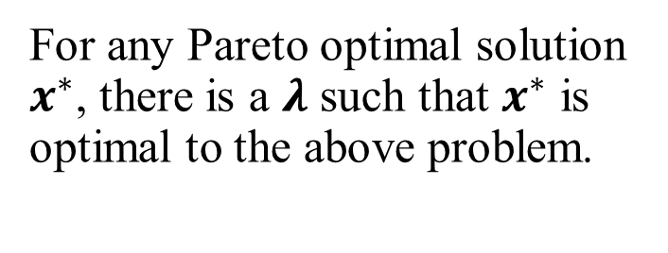
Tchebycheff approach
Minimization
For any Pareto optimal solution $x^{∗}$, there is a $λ$ such that $x^{∗}$ is optimal to the above problem.

Slide 47
What does a subproblem contain?
Inputs: $\left\{\begin{aligned}\begin{aligned}\text{a} \text{decomposition} \text{function} g \\ \text{preference} \text{vector} λ \\ \text{possibly} \text{a} \text{reference} \text{point} z^{∗}\end{aligned} \\ The search space D of x \\ The best−so−far solution\end{aligned}\right.$
$$\min{g\left(x\right)}$$

Slide 48
Collaboration of neighboring subproblems
Neighborhood: define the relationship among subproblems
Two subproblems are neighbors if their weight vectors are close.
Neighboring subproblems should have similar objective functions and thus similar optimal solutions with high probability.
Minimization
Neighborhood of problem 5

Slide 49
How to collaborate?
A simple way is by crossover between a subproblem and its neighbours
The best-so-far solution for the subproblem
$$x_{1}$$ | $$x_{2}$$ | $$x_{3}$$ | $$x_{4}$$ | $$x_{5}$$ | $$x_{6}$$ | $$x_{7}$$ | $$x_{8}$$ | $$x_{9}$$
$$y_{1}$$ | $$y_{2}$$ | $$y_{3}$$ | $$y_{4}$$ | $$y_{5}$$ | $$y_{6}$$ | $$y_{7}$$ | $$y_{8}$$ | $$y_{9}$$
Another best-so-far solution randomly selected from one of its neighbours
$$x_{1}$$ | $$x_{2}$$ | $$x_{3}$$ | $$y_{4}$$ | $$y_{5}$$ | $$y_{6}$$ | $$y_{7}$$ | $$x_{8}$$ | $$x_{9}$$
The reproduced offspring solution

Slide 50
The overall procedure of MOEA/D
At each generation, each subproblem does the following:
Mating pool selection: obtain the current solutions (i.e., best so far) of some neighbors (collaboration).
2. Reproduction: generate a new solution by applying crossover and mutation.
Replacement:
replace its old solution by the new one if the new one is better in terms of its objective.
pass the new solution to some of its neighbours, each of whom replaces its old solution by this new one if it is better in terms of their own objectives. (collaboration, neighborhood)

Slide 51
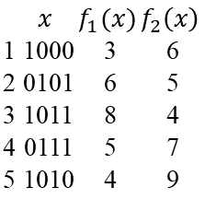
Illustration of MOEA/D
Search Space
0101
0100
0001
0000
1101
0110
0111
1010
1000
1100
1011
1111
1001
0010
0011
1110
Current Population
 | $$x$$ | $$f_{1}(x)$$ | $$f_{2}\left(x\right)$$
1 | 1000 | 3 | 6
2 | 0101 | 6 | 5
3 | 1011 | 8 | 4
4 | 0111 | 5 | 7
5 | 1010 | 4 | 9
Subproblem ID

Slide 52
Illustration of MOEA/D
Search Space
0101
0100
0001
0000
1101
0110
0111
1010
1000
1100
1011
1111
1001
0010
0011
1110
For subproblem 1, the neighborhood is (1, 2, 3). So we randomly pick two from the three solutions
10|01
01|11
Crossover
Selected Parents
10|11
Current Population
0101
1011
Mutation
1001
 | $$x$$ | $$f_{1}(x)$$ | $$f_{2}\left(x\right)$$
1 | 1000 | 3 | 6
2 | 0101 | 6 | 5
3 | 1011 | 8 | 4
4 | 0111 | 5 | 7
5 | 1010 | 4 | 9
Subproblem ID

Slide 53
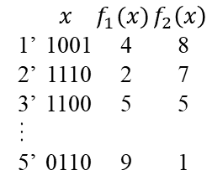
Illustration of MOEA/D
Search Space
0101
0100
0001
0000
1101
0110
0111
1010
1000
1100
1011
1111
1001
0010
0011
1110
For subproblem 1, the neighborhood is (1, 2, 3). So we randomly pick two from the three solutions
10|01
01|11
Crossover
Selected Parents
10|11
Current Population
0101
1011
Mutation
1001
 | $$x$$ | $$f_{1}(x)$$ | $$f_{2}\left(x\right)$$
1 | 1000 | 3 | 6
2 | 0101 | 6 | 5
3 | 1011 | 8 | 4
4 | 0111 | 5 | 7
5 | 1010 | 4 | 9
…
new Population
We do the same for subproblems 2 to 5.
 | $$x$$ | $$f_{1}(x)$$ | $$f_{2}\left(x\right)$$
1’ | 1001 | 4 | 8
2’ | 1110 | 2 | 7
3’ | 1100 | 5 | 5
…
5’ | 0110 | 9 | 1
Subproblem ID
Selected Parents
0111
1010
Mutation
0111
01|11
10|10
01|10
Crossover

Slide 54
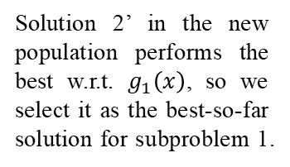
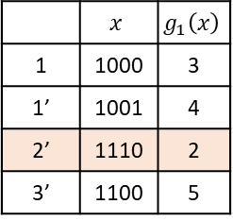
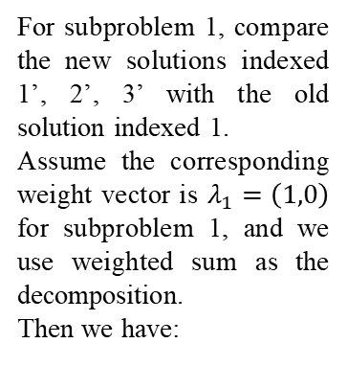
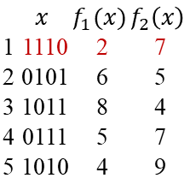
Illustration of MOEA/D
Search Space
0101
0100
0001
0000
1101
0110
0111
1010
1000
1100
1011
1111
1001
0010
0011
1110
For subproblem 1, compare the new solutions indexed 1’, 2’, 3’ with the old solution indexed 1.
Assume the corresponding weight vector is $λ_{1}=\left(1,0\right)$ for subproblem 1, and we use weighted sum as the decomposition.
Then we have:
Current Population
 | $$x$$ | $$f_{1}(x)$$ | $$f_{2}\left(x\right)$$
1 | 1000 | 3 | 6
2 | 0101 | 6 | 5
3 | 1011 | 8 | 4
4 | 0111 | 5 | 7
5 | 1010 | 4 | 9
 | $$x$$ | $$f_{1}(x)$$ | $$f_{2}\left(x\right)$$
1 | 1110 | 2 | 7
2 | 0101 | 6 | 5
3 | 1011 | 8 | 4
4 | 0111 | 5 | 7
5 | 1010 | 4 | 9
new Population
 | $$x$$ | $$f_{1}(x)$$ | $$f_{2}\left(x\right)$$
1’ | 1001 | 4 | 8
2’ | 1110 | 2 | 7
3’ | 1100 | 5 | 5
…
5’ | 0110 | 9 | 1
 | $$x$$ | $$g_{1}\left(x\right)$$
1 | 1000 | 3
1’ | 1001 | 4
2’ | 1110 | 2
3’ | 1100 | 5
Subproblem ID
replacement
Solution 2’ in the new population performs the best w.r.t. $g_{1}\left(x\right)$, so we select it as the best-so-far solution for subproblem 1.
And we will do the same
replacement for subproblems 2 to 5.

Slide 55
What have you learned?
Multiobjective optimization
Formulation and fundamental concepts
The paradigm of evolutionary multiobjective optimization
MOEA/D
Decomposition methods
The collaboration of subproblems

Slide 56
MATLAB Implementation of MOEA/D

Slide 57
Code structure
demo.m
Entrance of program, testing MOEA/D with an MOP benchmark called ZDT1.
MOEAD.m
MOEAD code for unconstrained continuous MOPs.
Tchebysheff.m
The Tchebysheff aggregation function.
ZDT1.m
The benchmark for testing.

Slide 58
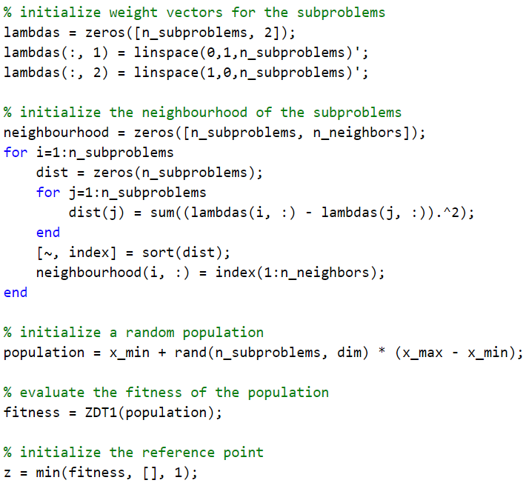
MOEA/D initialization

Slide 59
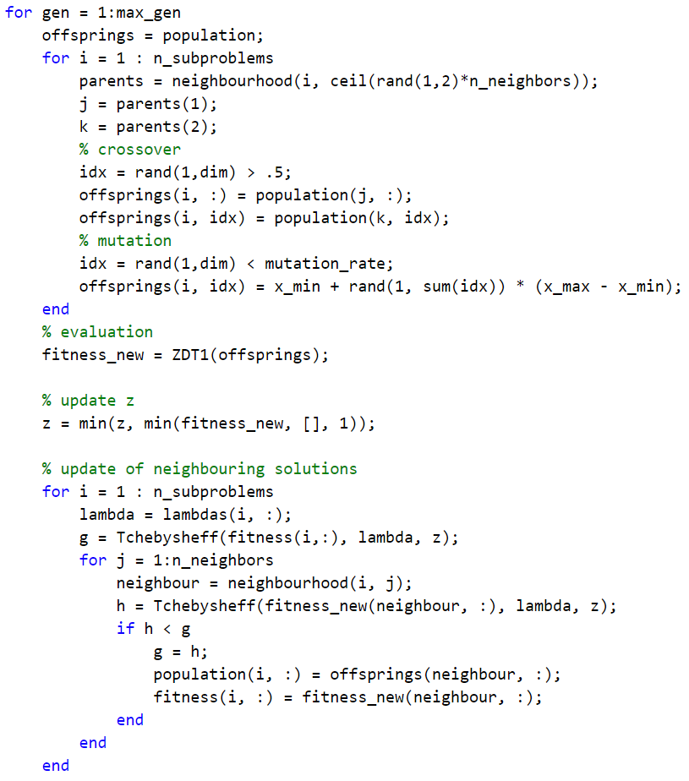
MOEA/D update
Collaboration
Decomposition

Slide 60
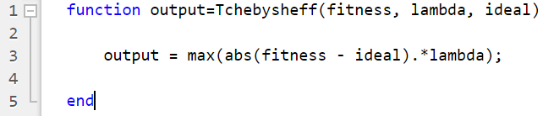
Tchebysheff implementation

Slide 61
Result demonstration: the approximated PF
The ZDT 1 benchmark problem
Minimization

Slide 62
Thanks!
Notes:
As in slide

